Slide 1
INT234 UNIT 1 Introduction and Data Preparation
Amanpal Singh

Slide 2
1. Introduction to Predictive Analytics
It is the process of using data to forecast future outcomes.
It uses data analysis, machine learning, artificial intelligence, and statistical models to find patterns that might predict future behavior.
Organizations can use historic and current data to forecast trends and behaviors seconds, days, or years into the future with a great deal of precision.

Slide 3
1.1 Introduction and Data Preparation
Data preparation involves collecting, cleaning, and transforming raw data.
Importance: Ensures high-quality input, reduces bias.
Steps: Data collection, cleaning, transformation, normalization.

Slide 4
1.2 Introduction to Predictive Analytics
Definition: Uses data and algorithms to predict outcomes.
Objective: Forecast trends and behaviors.
Applications: Churn prediction, credit scoring, fraud detection.

Slide 5
1.3 The workflow for building predictive analytics
Define the problem: A prediction starts with a good thesis and set of requirements.
Acquire and organize data: decades of data to draw upon, or a continual flood of data from customer.
Pre-process data: Raw data should be cleaned to remove anomalies, missing data points, or extreme outliers, any of which might be the result of input or measurement errors.
Develop predictive models: Machine learning, regression models, and decision trees are some of the most common types of predictive models.
Validate and deploy results: Check on the accuracy of the model and adjust accordingly.

Slide 6
1.4 predictive analytics techniques
In general, there are two types of predictive analytics models:
Classification models attempt to put data objects into one category or another.
Regression models try to predict continuous data, such as how much revenue that customer will generate during their relationship with the company.

Slide 7
2.1 Machine Learning
It is a subfield of artificial intelligence, which is broadly defined as the capability of a machine to imitate intelligent human behavior.
Artificial intelligence systems are used to perform complex tasks in a way that is similar to how humans solve problems.
Types: Supervised, Unsupervised, Reinforcement.
Role: Builds predictive models, improves accuracy.

Slide 8
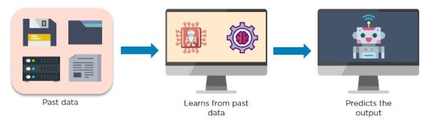
2.1.1 Working of Machine Learning
Machine learning accesses vast amounts of data (both structured and unstructured) and learns from it to predict the future.
It learns from the data by using multiple algorithms and techniques

Slide 9
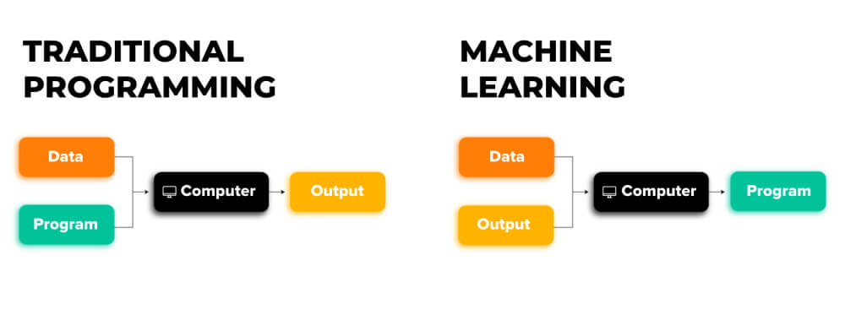
2.1.2 Traditional vs ML
Source: avenga.com/

Slide 10
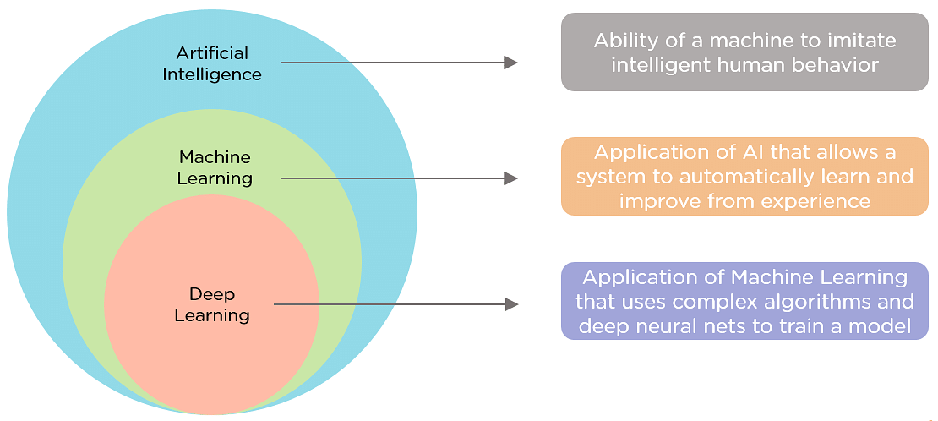
2.1.3 AI/ML/DL
Source: simplilearn

Slide 11
2.2.1 Supervised Learning
Definition: It is a type of machine learning where a model is trained on a labeled dataset.
This means that for each input in the training data, there is a corresponding correct output or "label."Goal: Map inputs to outputs.
Examples: Regression (sales prediction), Classification (spam detection).

Slide 12
2.2.2 Unsupervised learning
Unsupervised learning is a type of machine learning that focuses on discovering hidden patterns and structures within unlabeled datasets.
algorithms are given only input data and must identify relationships, groupings, or features without any prior guidance or feedback on what the correct output should be.

Slide 13
2.2.3 Supervised vs unSupervised
Feature | Supervised Learning | Unsupervised Learning
Definition | The model learns using labeled data. | The model learns from unlabeled data.
Training Data | Contains input-output pairs (e.g., (X, Y)) | Contains only input data (X), no output labels.
Objective | Predict outcomes or classify data accurately. | Discover hidden patterns, groupings, or structures.
Output | Predicts labels or values (classification/regression). | Finds clusters, associations, or dimensionality reduction.
Examples | Spam detection, image classification, stock price prediction | Customer segmentation, topic modeling, anomaly detection
Algorithms Used | Linear regression, SVM, Decision Trees, k-NN, Neural Networks | K-Means, PCA, DBSCAN, Hierarchical Clustering
Label Requirement | Requires labeled data for training. | No labels required during training.
Complexity | Typically easier to evaluate (based on accuracy, RMSE, etc.) | Harder to evaluate (based on clustering quality, silhouette score)
Real-time Applications | Fraud detection, email filtering, speech recognition | Market segmentation, social network analysis, recommender systems
Evaluation Metrics | Accuracy, Precision, Recall, RMSE, F1-score | Silhouette score, Davies-Bouldin Index, clustering purity

Slide 14
3. Mathematical Explanation supervise learning
We are given a dataset of input-output pairs:
D={(x1,y1),(x2,y2),…,(xn,yn)}
X i​: input feature(s) (e.g., height, age)
Y i​: corresponding output label (e.g., weight, class)
The goal is to learn a function f(x) such that:
f(X i)≈ Y i​

Slide 15
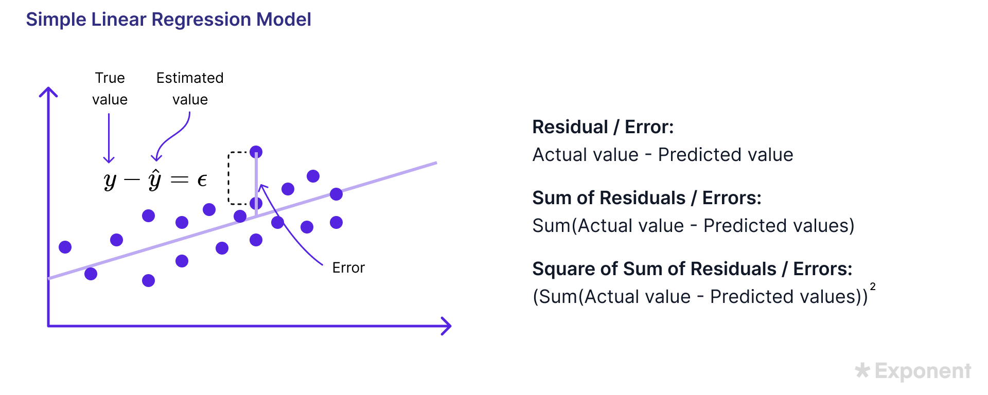
3.1 Linear Regression (a Supervised Learning Algorithm)
We assume: y=mx+b
Where: m: slope (weight), b: intercept (bias)
Source: https://www.tryexponent.com/courses/statistics-experimentation-questions/linear-regression-concepts

Slide 16
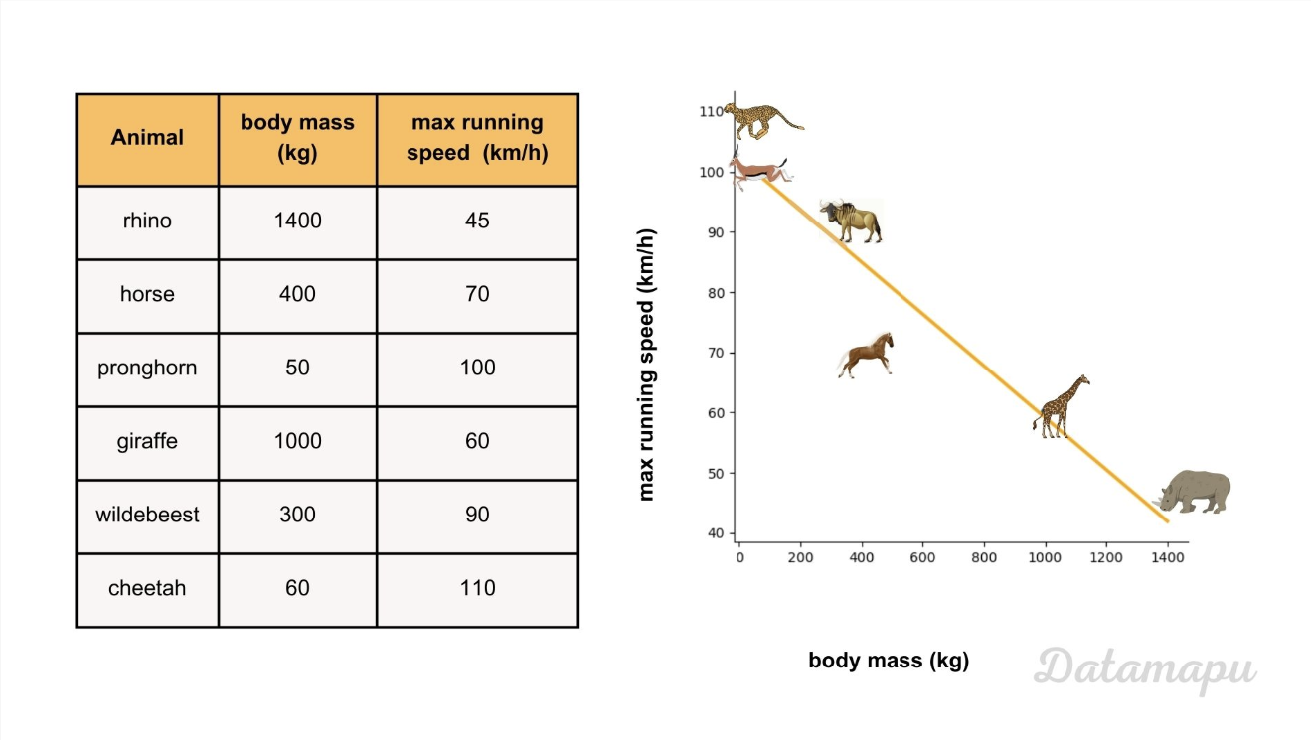

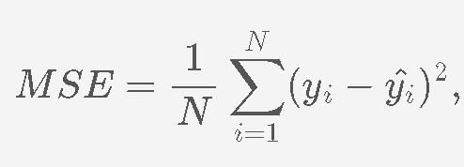
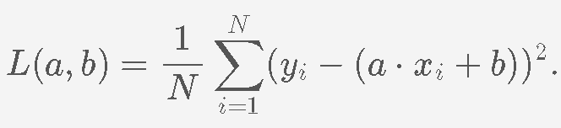
Linear regression
Fit the Model
Independent variable / input feature: body mass
Dependent / target variable: speed
We need to minimize the error between the predictions and the actual values.
Source: https://datamapu.com/posts/classical_ml/linear_regression_example/

Slide 17
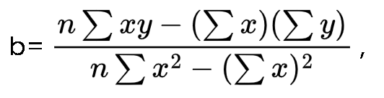
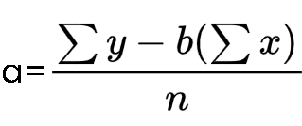
Example
X | Y | X*X | X*Y
2 | 3 | 4 | 6
3 | 6 | 9 | 18
5 | 5 | 25 | 25
8 | 12 | 64 | 96
18 | 26 | 102 | 145
X | 2 | 3 | 5 | 8
Y | 3 | 6 | 5 | 12
We need to determine the slope a and the intercept b, such that the loss function (here the MSE) is minimized.
Question 1) Find out the linear regression equation from the given set of data.
Using the simple linear regression formula.
Source https://www.vedantu.com/formula/linear-regression-formula

Slide 18
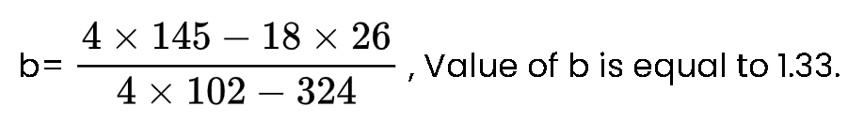
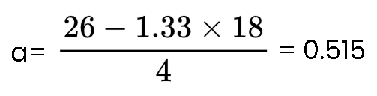
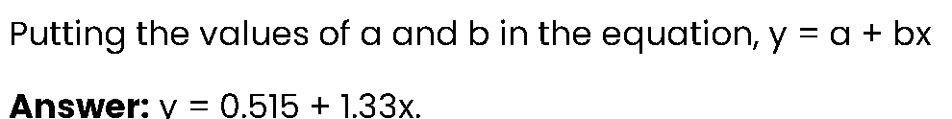
Source: https://www.vedantu.com/formula/linear-regression-formula

Slide 19
3.1.1 Supervised Learning - Python Code
from sklearn.linear_model import LinearRegression
model = LinearRegression()
model.fit(X_train, y_train)
predictions = model.predict(X_test)

Slide 20
3.1.2 (Implementation) Libraries in python
from sklearn.linear_model import LinearRegression
# Importing Linear Regression model from is an open-source #machine learning library for the Python programming language.
# LinearRegression:
# A machine learning model that fits a straight line to data
# (y = mx + b).
import numpy as np
# Importing NumPy for numerical operations
# numpy: Helps in working with arrays (our data).

Slide 21
Dataset: Training Set and model
# Input data: height (in cm) and corresponding weight (in kg)
X = np.array([[150], [160], [170], [180], [190]])
# Feature matrix (2D)
# X is a 2D array (required by scikit-learn).
Each inner list is one sample (height).
y = np.array([50, 58, 65, 72, 80]) # Target/output values
# y is a 1D array of corresponding weights.
model = LinearRegression() # Create the linear regression model
model.fit(X, y) # Train the model using the data
# Learns the best-fit line from the data — finds m (slope) and b (intercept).

Slide 22
Test Set
# Predicting weight for new height values, test data
X_test = np.array([[155], [165], [175]])
# New height values
y_pred = model.predict(X_test)
# Predicting weight
# X_test: New unseen heights we want predictions for.
# Gives predicted weights using the learned mode

Slide 23
Result of prediction
# Display predictions
for i in range(len(X_test)):
print(f"Height: {X_test[i][0]} cm => Predicted Weight: {y_pred[i]:.2f} kg")
# for plain output use simply: print(y_pred)

Slide 24
Addon: plotting the result
import matplotlib.pyplot as plt
# Actual points
plt.scatter(X, y, color='blue', label='Training Data')
# Predicted points
plt.scatter(X_test, y_pred, color='green', label='Predictions’)
# Fitted line
plt.plot(X, model.predict(X), color='red', label='Best Fit Line’)
#plt.xlabel('Height (cm)')
#plt.ylabel('Weight (kg)')
plt.title('Linear Regression')
plt.legend()
plt.show()

Slide 25
4. Unsupervised Learning
Definition: Learning from data without labels.
Goal: Discover hidden patterns.
Examples: Clustering (segmentation), PCA (dimensionality reduction).

Slide 26
4.1 Unsupervised Learning - Python Code
from sklearn.cluster import KMeans
model = KMeans(n_clusters=3)
model.fit(data)
labels = model.labels_
Will be covered in detail in the respective chapter/topic.

Slide 27
5 Data Preprocessing
Definition: Prepares raw data for models.
Techniques: Missing values, encoding, scaling, outlier detection.
Data Preprocessing is a crucial first step in any machine learning pipeline.
It prepares raw data into a clean and structured form so that ML algorithms can learn effectively.

Slide 28
5.1. Handling Missing Data
Real-world datasets often have missing values — empty cells, NaNs, or nulls.
Solutions:
Remove rows/columns with missing data.
Impute values (mean, median, mode).

Slide 29
5.1.1 Empty Cells
Empty cells are literally cells in a table or spreadsheet that contain no data.
They can be the result of data entry errors or simply missing information.
In some contexts, like CSS, they can be styled differently to show or hide borders and backgrounds.
When reading data, software might interpret them as zero, or convert them to NaN or null.

Slide 30
5.1.2 NaN (Not a Number)
NaN represents an undefined or unrepresentable numerical value.
It's a specific value in floating-point number systems.
It's often the result of mathematical operations that don't make sense, like dividing by zero (0.0/0.0) or taking the square root of a negative number.
While it's a numerical value, it's not a number in the traditional sense.
In some programming languages like Python and Polars, NaN is used to represent missing numerical data.

Slide 31
5.1.3 Null
Null represents the absence of a value, indicating that a variable or cell has no assigned value.
It's a more general concept than NaN and can be used for various data types.
In databases, null represents a missing value that is not equivalent to zero or an empty string.
In programming, null is often used to indicate that a variable has not been assigned a value or that a function call did not return a meaningful result.
In some programming contexts, like Python, null is represented by the keyword None

Slide 32
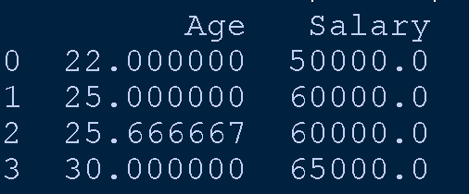
6.1 Handling Missing Data (python)
import pandas as pd
import numpy as np
data = {'Age': [22, 25, np.nan, 30],
'Salary': [50000, np.nan, 60000, 65000]}
df = pd.DataFrame(data)
# Impute missing values correctly
# Mean imputation for Age
df['Age'] = df['Age'].fillna(df['Age'].mean())
# Median imputation for Salary
df['Salary'] = df['Salary'].fillna(df['Salary'].median())
print(df)

Slide 33
NumPy vs Pandas
NumPy (Numerical Python) provides the foundational structures and operations for numerical computing in Python. Its core feature is the ndarray.
Pandas is built on top of NumPy and provides higher-level data structures and tools for data manipulation and analysis, particularly with structured or tabular data.

Slide 34
6.2. Encoding Categorical Variables
ML models can’t handle text labels — they need numbers.
Solutions:
One-Hot Encoding (for nominal): Creates new binary (0 or 1) columns for each category.
Label Encoding (for ordinal): Assigns a numerical label (integer) to each category.
Nominal data consists of categories that are mutually exclusive and have no inherent order or ranking. Eg: Colors: Red, blue, green.
Ordinal data represents categories that can be ordered or ranked, but the intervals between the categories are not necessarily equal. Eg: Income Level: Low, medium, high.

Slide 35
Nominal vs Ordinal Data
Feature | Nominal Data | Ordinal Data
Order/Ranking | ❌ No | ✅ Yes
Equal Intervals | ❌ Not applicable | ❌ Not guaranteed
Examples | Hair color, gender | Satisfaction, education
Suitable Analysis | Frequency, mode | Median, rank-based tests

Slide 36
6.2.1 Use of One-Hot Encoding?
Machine learning models don’t understand text, so categorical variables like "Red" or "Green" must be converted to numbers.
One-hot encoding avoids assigning arbitrary numerical ranks, which could mislead the model if it thinks there's an order.

Slide 37
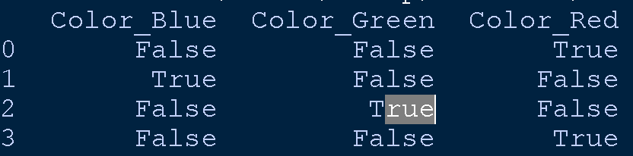
One-Hot Encoding example
# Essential for working with structured/tabular data like DataFrames in Python
import pandas as pd
# Creates a DataFrame named df with one column called "Color"
df = pd.DataFrame({'Color': ['Red', 'Blue', 'Green', 'Red’]})
# Applies one-hot encoding to the "Color" column.
# This converts each unique category (Red, Blue, Green) into #its own binary column.
encoded_df = pd.get_dummies(df, columns=['Color'])
# Now, your "Color" column has been replaced by three new columns.
print(encoded_df)

Slide 38
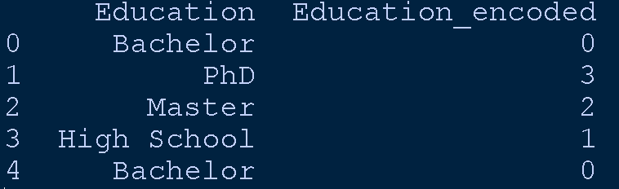
6.2.2 Label Encoding
⚠️ Note: LabelEncoder assigns integers alphabetically by default unless you manually define the order.
import pandas as pd
from sklearn.preprocessing import LabelEncoder
df = pd.DataFrame({
'Education': ['Bachelor', 'PhD', 'Master', 'High School', 'Bachelor']
})
le = LabelEncoder() # Initialize encoder
# Fit and transform
df['Education_encoded'] = le.fit_transform(df['Education'])
print(df) #⚠️ Note: LabelEncoder assigns integers alphabetically by default unless you manually define the order.

Slide 39
6.3. Feature Scaling / Normalization
Features on different scales can bias the model.
Solutions:
Min-Max Scaling → scales to [0, 1]
Standardization → mean = 0, std = 1

Slide 40
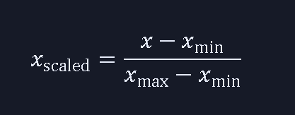
6.3.1 Min-Max Scaling
Min-Max Scaling uses:
So, all values lie between 0 and 1.

Slide 41
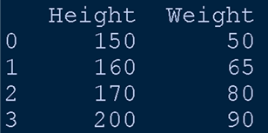
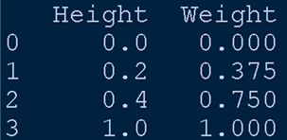
6.3.1 Code example
# Importing the scaler that will convert feature ranges to [0, 1]
from sklearn.preprocessing import MinMaxScaler
# Sample dataset with different scales for 'Height' and 'Weight'
import pandas as pd
data = {'Height': [150, 160, 170,200], # centimeters
'Weight': [50, 65, 80,90]} # kilograms
df = pd.DataFrame(data) # Creating a DataFrame
print(df) # View original values
# Create an instance of the MinMaxScaler
scaler = MinMaxScaler()
# Fit the scaler to the data and transform it to [0, 1] range
scaled = scaler.fit_transform(df) # Returns a NumPy array
# Convert the scaled array back to a DataFrame for readability
scaled_df = pd.DataFrame(scaled, columns=df.columns)
print(scaled_df) # View scaled values

Slide 42
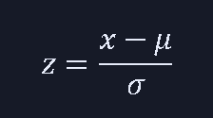
6.3.2 Standardization (Z-score normalization)
Standardization uses the formula:
Where:
μ is the mean of the feature
σ is the standard deviation
This ensures:
Mean becomes ~0
Standard deviation becomes ~1
No feature dominates the model due to larger scales

Slide 43
StandardScaler
The StandardScaler in Python, provided by the scikit-learn library, is a preprocessing tool used to standardize features by removing the mean and scaling them to unit variance.
This ensures that each feature has a mean of 0 and a standard deviation of 1, which is particularly useful for machine learning algorithms sensitive to feature scaling.
Mean Removal: Centers the data around 0.
Unit Variance: Scales the data so that the standard deviation is 1.
Feature-wise Scaling: Operates independently on each feature (column).

Slide 44
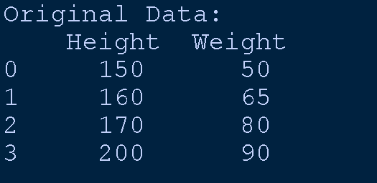
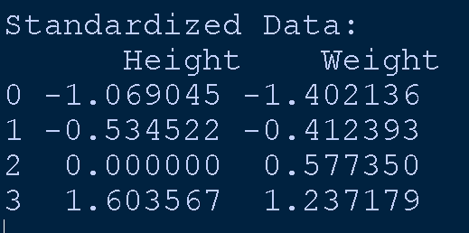
# Step 1: Import necessary libraries
import pandas as pd
from sklearn.preprocessing import StandardScaler
# Step 2: Define sample data with different scales
data = {
'Height': [150, 160, 170, 200], # in centimeters
'Weight': [50, 65, 80, 90] # in kilograms
}
# Step 3: Create a DataFrame for easy viewing and manipulation
df = pd.DataFrame(data)
print("Original Data:\n", df)
# Step 4: Create an instance of StandardScaler
scaler = StandardScaler()
# Step 5: Fit the scaler to the data and transform it
standardized_array = scaler.fit_transform(df)
# Step 6: Convert the result back to a DataFrame with the same column names
standardized_df = pd.DataFrame(standardized_array, columns=df.columns)
print("\nStandardized Data:\n", standardized_df)

Slide 45
6.4. Removing Duplicates
Duplicate rows introduce redundancy.
Solution:
df = df.drop_duplicates()

Slide 46
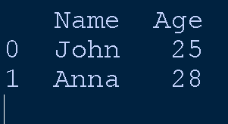
Removing Duplicates code
import pandas as pd
df = pd.DataFrame({'Name': ['John', 'Anna', 'John'],
'Age': [25, 28, 25]})
df = df.drop_duplicates()
print(df)

Slide 47
6.5. Outlier Detection and Handling
Outliers can skew the model.
Methods:
Z-score
IQR (Interquartile Range)
Manual thresholds

Slide 48
Outliers
Outliers are observations that lie far outside the range of most other values in a dataset.
They can result from:
Measurement errors
Data entry mistakes
Natural variability
Rare events
Impact | Description
🧮 Skewed Statistics | They distort mean, variance, and correlation
📉 Model Performance | Can mislead regression or clustering algorithms
🧠 Insight or Noise | Sometimes they reveal hidden patterns, sometimes they're just junk

Slide 49
Outliers
import pandas as pd
# Sample data with one clear outlier
data = {'Salary': [1,2,2,1,2,1,2,1,2,1,2,1,2,1,2,1,2,1,3,2,2,1, 1000000]} # 1000000 is likely an outlier
df = pd.DataFrame(data)
print("Original Data:\n", df)

Slide 50
6.5 a) Z-Score Method
z_scores = (data - mean) / std_dev
It subtracts the mean from each data point and divides the result by the standard deviation.
Values with Z-score > 3 or < -3 are considered outliers.
🔍 Visual Detection
Boxplot: Outliers appear as dots beyond whiskers.
Scatterplot: Points far from clusters.
Histogram: Long tails or isolated bars.

Slide 51
a) Z-score (Standardization based)
from scipy import stats
import numpy as np
import pandas as pd
data = {'Salary': [1,2,2,1,2,1,2,1,2,1,2,1,2,1,2,1,2,1,3,2,2,1, 1000000]} # 1000000 is likely an outlier
df = pd.DataFrame(data)
# Calculate z-scores for each value
z_scores = stats.zscore(df['Salary'])
# Identify outliers: absolute z-score > 3
outliers = np.where(np.abs(z_scores) > 3)
print("\nZ-score Outliers:\n", df.iloc[outliers])

Slide 52
Verifying z-score with formula
mean = df['Salary'].mean() # ~43479
std_dev = df['Salary'].std() # ~208514
z_1000000 = (1000000 - mean) / std_dev # ≈ 4 (well above 3)
print(str(mean) +"\t"+ str(std_dev) +"\t"+ str(z_1000000))
# We suspect it’s an outlier just by looking at the data
# Then suddenly, boom — ₹1,000,000 shows up, So to check how unusual it really is,
# we calculate its z-score:
# z_1000000 = (1000000 - mean) / std_dev
# We didn’t do this for all values
# because the others are clearly within the “normal” range

Slide 53
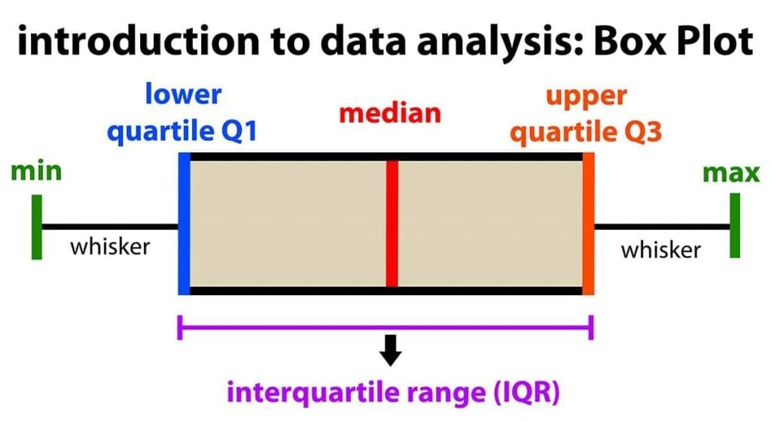
Reading Box Plot
Interquartile Range (IQR): The box plot shows the middle 50% of scores (i.e., the range between the 25th and 75th percentile).
Whiskers: The upper and lower whiskers represent scores outside the middle 50% (i.e., the lower 25% of scores and the upper 25% of scores).

Slide 54
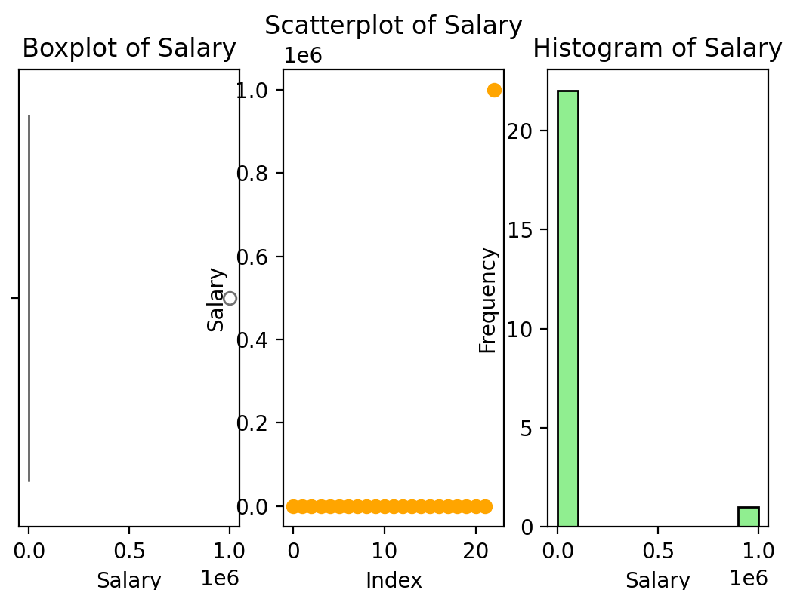

Slide 55
🔍 Visual Detection code
import matplotlib.pyplot as plt
import seaborn as sns
# Sample data
data = {'Salary': [1,2,2,1,2,1,2,1,2,1,2,1,2,1,2,1,2,1,3,2,2,1,1000000]}
salaries = data['Salary']
# Set up the plotting canvas
# 📦 Boxplot
plt.subplot(1, 3, 1)
sns.boxplot(x=salaries, color='skyblue')
plt.title('Boxplot of Salary')
plt.xlabel('Salary')
# 🔘 Scatterplot
plt.subplot(1, 3, 2)
plt.scatter(range(len(salaries)), salaries, color='orange')
plt.title('Scatterplot of Salary')
plt.xlabel('Index')
plt.ylabel('Salary')
# 📊 Histogram
plt.subplot(1, 3, 3)
plt.hist(salaries, bins=10, color='lightgreen', edgecolor='black')
plt.title('Histogram of Salary')
plt.xlabel('Salary')
plt.ylabel('Frequency')
# Show all plots
plt.show()

Slide 56
Visual inspection
📦 Boxplot – Spot the Dot! :Shows the distribution and highlights the outlier as a dot far beyond the whiskers.
🔘 Scatterplot – Lone Ranger : Each salary is plotted by index. The outlier stands out dramatically from the cluster.
📊 Histogram – Long Tail Trouble : Most salaries are tightly packed, but the outlier creates a long tail on the right.

Slide 57
6.5 b) IQR (Interquartile Range)
Quartiles: Quartiles divide a data set into four equal parts. Q1 (first quartile) represents the 25th percentile, Q2 (second quartile) is the median (50th percentile), and Q3 (third quartile) represents the 75th percentile.
Interquartile Range: The IQR measures the spread of the middle 50% of the data, showing how much the data varies within that range.
Formula: IQR = Q3 - Q1.

Slide 58
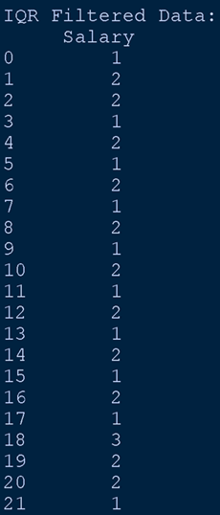
b) IQR (Interquartile Range) method
from scipy import stats
import numpy as np
# Calculate Q1 (25th percentile)
#and Q3 (75th percentile)
Q1 = df['Salary'].quantile(0.25)
Q3 = df['Salary'].quantile(0.75)
IQR = Q3 - Q1
# Define outlier range
lower_bound = Q1 - 1.5 * IQR
upper_bound = Q3 + 1.5 * IQR
# Filter non-outlier values
f_df = \
df[(df['Salary'] >= lower_bound) & (df['Salary'] <= upper_bound )]
print("\nIQR Filtered Data:\n", f_df)

Slide 59
Explanation of IQR
data = {'Salary': [1,2,2,1,2,1,2,1,2,1,2,1,2,1,2,1,2,1,3,2,2,1,1000000]}
Sorted: [1,1,1,1,1,1,1,1,1,1,1,1,1,1,1,1,1,2,2,2,2,2,3,1000000]
# Interpolates between index 5 and 6: both values = 1 → Q1 = 1.0
pos_Q1 = (n - 1) * 0.25 = (23 - 1) * 0.25 = 5.5
# Interpolates between index 16 (value=2) and 17 (value=2) → Q3 = 2.0
pos_Q3 = (23 - 1) * 0.75 = 16.5
IQR = Q3 - Q1 = 2 - 1 = 1
Lower = Q1 - 1.5 * IQR = 1 - 1.5 = -0.5
Upper = Q3 + 1.5 * IQR = 2 + 1.5 = 3.5
#So only values between -0.5 and 3.5 are retained.

Slide 60
6.6. Feature Selection / Dimensionality Reduction
Remove irrelevant or correlated features to avoid overfitting.
Methods:
Correlation matrix
PCA (Principal Component Analysis) [advance]

Slide 61
6.6.a Correlation Coefficient (r):
Measures the strength and direction of a linear relationship between two variables. It ranges from -1 to +1.
+1 indicates a perfect positive correlation (as one variable increases, the other increases).
-1 indicates a perfect negative correlation (as one variable increases, the other decreases).
0 indicates no linear correlation.

Slide 62
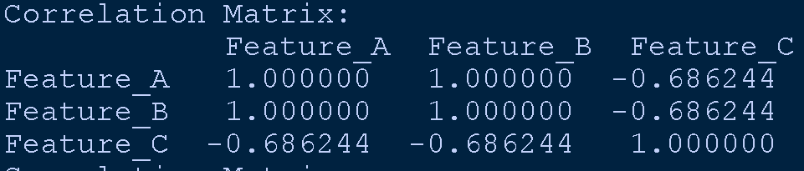
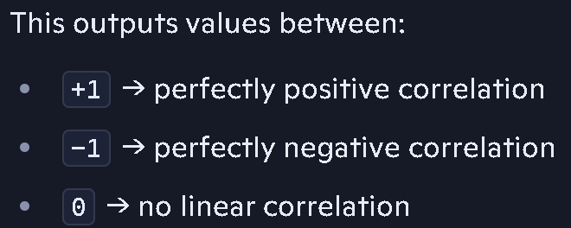
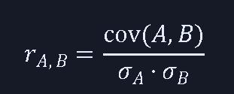
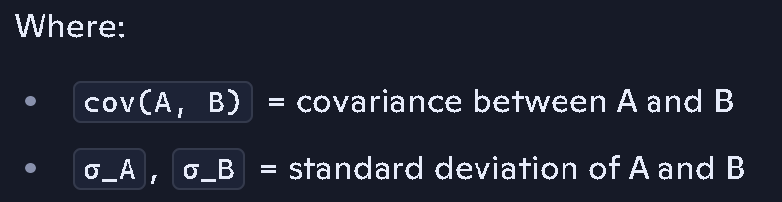
a) df.corr()
import pandas as pd
# Sample data with correlated features
data = {
'Feature_A': [1, 2, 3, 4, 5],
'Feature_B': [2, 4, 6, 8, 10], # Correlated with Feature_A
'Feature_C': [5, 3, 6, 2, 1] # Uncorrelated
}
df = pd.DataFrame(data)
# Calculate correlation matrix
corr_matrix = df.corr()
print("Correlation Matrix:\n", corr_matrix)
df_reduced = df.drop(columns=['Feature_B'])
Computes pairwise Pearson correlation coefficients between all numeric columns.

Slide 63
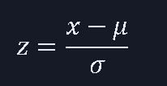
6.6.b PCA (Principal Component Analysis)
StandardScaler
x = value
μ = mean
σ = standard deviation
from sklearn.decomposition import PCA
# Imports the PCA class from scikit-learn, which helps reduce features while retaining the maximum variance.
from sklearn.preprocessing import StandardScaler
# Imports a tool to standardize the data — necessary before PCA.
# PCA is sensitive to scaling, so we must ensure all features contribute equally.
scaler = StandardScaler()
# Creates an instance of StandardScaler.
scaled_data = scaler.fit_transform(df)
# Fits the scaler to your df and transforms it.
# For each column, it subtracts the mean and divides by standard deviation.

Slide 64
pca = PCA(n_components=2)
# Creates a PCA object that will compute the top 2 principal components.
# These components are new directions (axes) capturing the most variance in data.
components = pca.fit_transform(scaled_data)
# Applies PCA to standardized data.
# Finds new axes (PC1 and PC2), projects data onto them.
pca_df = pd.DataFrame(components, columns=['PC1', 'PC2'])
print("\nPCA Result:\n", pca_df)
# Wraps the transformed data into a DataFrame.
# Columns PC1 and PC2 represent the new reduced feature space.
# This data is uncorrelated and optimized to retain the most information.

Slide 65
Comparison
Method | Use Case | Output
Correlation Matrix | Identify & drop redundant features | Original features cleaned
PCA | Compress correlated dimensions | New principal components

Slide 66
Common Text Cleaning Tasks
Lowercasing:
Standardizes text by converting everything to lowercase → 'Hello' → 'hello'
Removing Punctuation and Special Characters:
Cleans clutter → "I'm #1!!!" → "im 1"
Removing Numbers (optional): Especially if numbers aren't meaningful → "He is 99 years old" → "He is years old"
Removing Stopwords: Words like the, is, and that don’t add meaning in some contexts → "This is a test" → "test"
Stemming / Lemmatization: Reduces words to their root forms → "running" → "run" → "better" → "good"
Whitespace Handling: Trims excess spaces → " hello world " → "hello world“
The Natural Language Toolkit (NLTK) is a Python package for natural language processing.

Slide 67
Technique | Purpose | Tool/Function Used
Handling Missing Values | Fill or drop nulls | fillna(), dropna()
Encoding Categorical Data | Convert text to numbers | LabelEncoder, get_dummies()
Feature Scaling | Normalize features | StandardScaler, MinMaxScaler
Removing Duplicates | Remove redundant rows | drop_duplicates()
Outlier Handling | Remove or cap outliers | IQR, Z-score
Feature Selection | Choose relevant columns | Correlation, PCA
Text Cleaning | Process natural language text | nltk, re, stopword removal
Data Splitting | Divide data for training/testing | train_test_split()

Slide 68
Data Preprocessing - Python Code
from sklearn.preprocessing import StandardScaler
scaler = StandardScaler()
data_scaled = scaler.fit_transform(data)

Slide 69
Exploratory Data Analysis (EDA)
Exploratory Data Analysis (EDA) and Statistical Analysis help you understand, clean, and extract insights from data before modeling or automation.
EDA is the process of summarizing, visualizing, and understanding the structure of your dataset.
It can also help determine if the statistical techniques you are considering for data analysis are appropriate.
Python and EDA can be used together to identify missing values in a data set, which is important so you can decide how to handle missing values for machine learning.
Reading: https://www.kaggle.com/code/imoore/intro-to-exploratory-data-analysis-eda-in-python

Slide 70
1. Import Libraries
Import Libraries
pandas: Powerful library for data manipulation and analysis using DataFrames.
numpy: Core library for numerical computations and array operations.
matplotlib.pyplot: Plotting library for creating static, animated, and interactive visualizations.
Seaborn : High-level interface for attractive and informative statistical graphics built on top of matplotlib.
import pandas as pd
import numpy as np
import matplotlib.pyplot as plt
import seaborn as sns

Slide 71
2. Load the Dataset
Use pd.read_csv() for CSV files,
for Excel (pd.read_excel()) or
JSON (pd.read_json())
df = pd.read_csv("C:\\Users\\amanp\\OneDrive\\Desktop\\My data\\2526 1\\INT234 Predictive analysis\\Housing.csv")

Slide 72
3. Initial Data Inspection
df.head(): View the first few rows of the DataFrame to get a quick overview.
df.tail(): View the last few rows to check for any inconsistencies at the end.
df.info(): Get a concise summary of the DataFrame, including data types, non-null values, and memory usage.
df.shape: Check the number of rows and columns.
df.dtypes: Check the data types of each column

Slide 73
3. cont… Initial inspection
df.head()
# View the first few rows to get a glimpse of the data.
df.shape
# Understand the number of rows and columns.
df.info()
# Get a summary of the DataFrame, including data types and non-null counts.
df.describe()
# Obtain descriptive statistics for numerical columns (mean, median, standard deviation, quartiles).

Slide 74
4. Handle Missing Values
dentify and address missing values (NaNs). Common strategies include dropping rows/columns with excessive missing data or imputing missing values using methods like mean, median, or mode imputation.
df.isnull().sum() # Check for missing values
df.dropna() # Example: Drop rows with any missing values
df.fillna(df.mean()) # Example: Fill missing values with the mean

Slide 75
4.1 Numeric Columns & Textual Columns
Categorical Data :Keeps the distribution realistic
# Handle only numerical Columns data
df_numeric = df.select_dtypes(include='number')
df[df_numeric.columns] = df_numeric.fillna(df_numeric.mean())
# See the last row
df.iloc[-1]
df.tail(1)
# Fill Textual Columns with Mode (most frequent value)
df_object = df.select_dtypes(include='object')
for col in df_object.columns:
df[col] = df[col].fillna(df[col].mode()[0])
#Picks the first mode : df[col].mode()[0]

Slide 76
5. Handle Duplicates
Detect and remove duplicate rows if they exist.
df.duplicated().sum() # Check for duplicate rows
df.drop_duplicates(inplace=True) # Remove duplicate rows
Parameter | Behavior | Returns | Memory Efficiency
inplace=True | Modifies the original DataFrame directly | Returns None | ✅ More efficient
inplace=False (default) | Returns a new DataFrame with duplicates removed | Returns new DataFrame | ❌ Less efficient (creates a copy)

Slide 77
5. Analyse Data Types
Ensure columns have appropriate data types. Convert types if necessary (e.g., converting object type to datetime).
#Analyze Data Types
df.head
# Example: Convert to datetime
df['date'] = pd.to_datetime(df['date’])
df.head

Slide 78
6. Visualize and Interpret Results
The histplot function in Python is part of the Seaborn library and is used to visualize the distribution of a single or multiple numerical variables using histograms.
#Plot
ax = sns.histplot(df['price']);
ax.title("Histogram of House Price")
ax.set_xlabel('House Price') # Change x-axis label
ax.set_ylabel('Number of Items') # Change y-axis label
plt.show()
Reading Material: https://seaborn.pydata.org/generated/seaborn.histplot.html

Slide 79
Hist properties
bins: Controls the number or width of the histogram bins.
kde=True: Adds a Kernel Density Estimate (KDE) curve to the histogram, providing a smoothed representation of the distribution.
stat: Determines the statistic to be displayed on the y-axis (e.g., 'count', 'frequency', 'density', 'probability').
hue: Allows for creating separate histograms or stacked/dodged histograms based on a categorical variable.
multiple: Controls how multiple distributions are plotted when hue is used (e.g., 'layer', 'stack', 'dodge').
color: Sets the color of the histogram bars.
log_scale: Applies a logarithmic scale to the x or y axis.

Slide 80
Hist properties code
# Pass the full DataFrame and specify the column name
sns.histplot(data=df, x='price', bins=10)
# Pass the Series directly and omit
sns.histplot(df['price'], bins=10)
plt.show()
For more information: https://seaborn.pydata.org/generated/seaborn.histplot.html

Slide 81
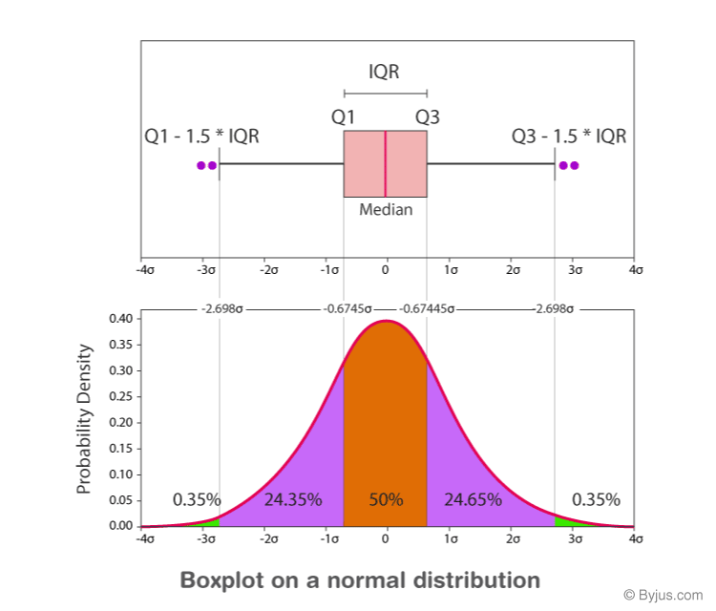
boxplot
A boxplot, also known as a box and whisker plot, is a standardized way of displaying the distribution of data based on a five-number summary: minimum, first quartile (Q1), median (Q2), third quartile (Q3), and maximum.
It provides a visual representation of the data's central tendency, spread, and skewness.
Reading: https://byjus.com/maths/box-plot/#boxplot-distribution

Slide 82
Summary
Predictive analytics forecasts future outcomes.
Data preparation ensures model quality.
Machine learning enables predictive modeling.
Data preprocessing is essential.

Slide 83
Thank You
Questions?
Keep Exploring the Future with Data!

